Slide 1
JAVA PROGRAMMING
Chap 3 : Inheritance

Slide 2
Inheritance is an important pillar of OOP(Object-Oriented Programming).
It is the mechanism in java by which one class is allowed to inherit the features(fields and methods) of another class.
In Java, inheritance means creating new classes based on existing ones.
A class that inherits from another class can reuse the methods and fields of that class.
In addition, you can add new fields and methods to your current class as well.
Inheritance represents the IS-A relationship which is also known as a parent-child relationship.
Important terminologies used in Inheritance:
Class: Class is a set of objects which shares common characteristics/ behavior and common properties/ attributes. Class is not a real-world entity. It is just a template or blueprint or prototype from which objects are created.
Super Class/Parent Class/Base Class: The class whose features are inherited is known as a superclass(or a base class or a parent class).
Sub Class/Child Class/Derived Class: The class that inherits the other class is known as a subclass(or a derived class, extended class, or child class). The subclass can add its own fields and methods in addition to the superclass fields and methods.
Reusability: Inheritance supports the concept of “reusability”, i.e. when we want to create a new class and there is already a class that includes some of the code that we want, we can derive our new class from the existing class. By doing this, we are reusing the fields and methods of the existing class.

Slide 3
Why do we need Inheritance in Java?
Code Reusability: The code written in the Superclass is common to all subclasses. Child classes can directly use the parent class code.
Method Overriding: Method Overriding is achievable only through Inheritance. It is one of the ways by which java achieves Run Time Polymorphism.
Abstraction: The concept of abstract where we do not have to provide all details is achieved through inheritance. Abstraction only shows the functionality to the user.
Syntax for inheritance
The extends keyword is used for inheritance in java. Using the extends keyword indicates you are derived from an existing class. In other words, “extends” refers to increased functionality.
Syntax : class derived_class extends base_class
{
//methods and fields
}
Types of Inheritance :
Single Inheritance
Multilevel Inheritance
Hierarchical Inheritance

Slide 4
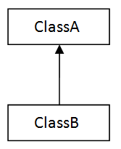

Single Inheritance
Here only one class is derived from another class.
import java.util.*;
class Data { // Base class Data
float r;
public void read(float x)
{
r=x;
}}
class Area extends Data // creating child class Area
{
private float a;
public void calculate()
{
a=3.14f*r*r;
}
public void display()
{
System.out.println("Area is : "+a);
}}
class Main
{
public static void main(String args[])
{
float rad;
Scanner sc=new Scanner(System.in);
System.out.println("Enter Radius : ");
rad=sc.nextFloat();
Area ar=new Area();
ar.read(rad);
ar.calculate();
ar.display();
}}

Slide 5
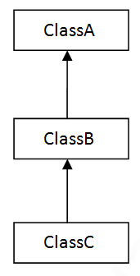
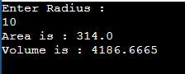
Multilevel Inheritance
Here one class is derived from a class which is in turn derived from another class.
import java.util.*;
class Data { // Base class Data
float r;
public void read(float x)
{
r=x;
}}
class Area extends Data // creating child class Area of parent class Data
{
protected float a;
public void calculate()
{
a=3.14f*r*r;
}
public void display()
{
System.out.println("Area is : "+a);
}}
class Volume extends Area // creating child class Volume of parent class Area
{
private float vol;
public void compute()
{
vol=a*r*4/3;
}
public void show()
{
System.out.println("Volume is : "+vol);
}}
class Main
{
public static void main(String args[])
{
float rad;
Scanner sc=new Scanner(System.in);
System.out.println("Enter Radius : ");
rad=sc.nextFloat();
Volume v=new Volume();
v.read(rad);
v.calculate();
v.display();
v.compute();
v.show();
}
}

Slide 6
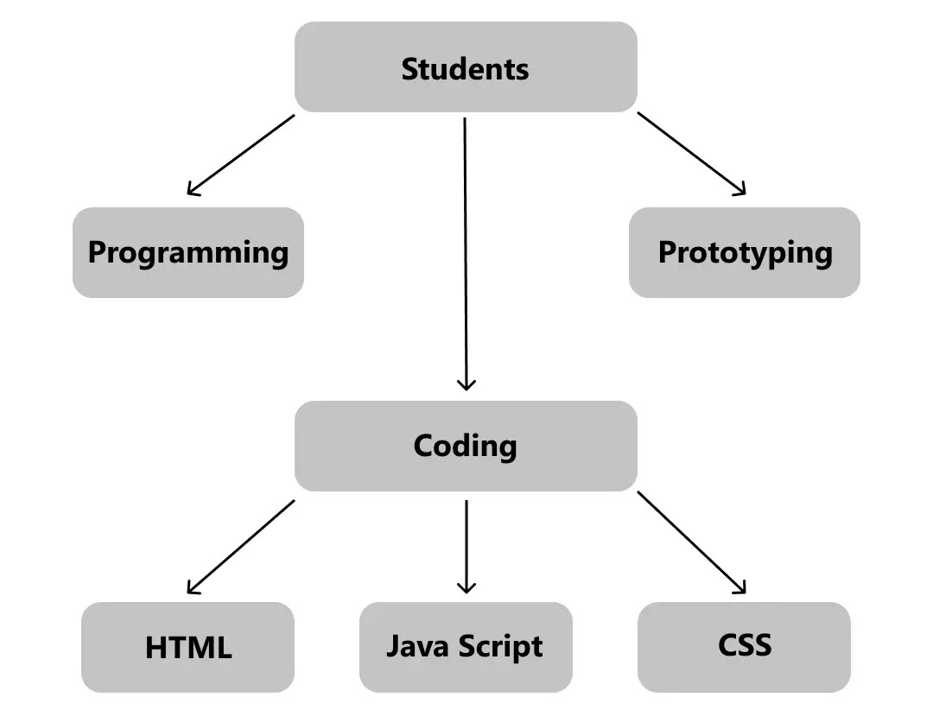
Hierarchical Inheritance
When multiple classes are derived from a class and further more classes are derived from these derived classes
one class serves as a superclass (base class) for more than one subclass
Example from codes

Slide 7
Hierarchical Inheritance
// parent class
class Employee {
double salary = 50000;
void displaySalary() {
System.out.println("Employee Salary: Rs."+salary);
}
}
// child class 1
class FullTimeEmployee extends Employee{
double hike = 0.50;
void incrementSalary() {
salary = salary + (salary * hike);
System.out.println("Full Time Employee Salary after increement : "+salary);
}
}
// child class 2
class InternEmployee extends Employee{
double hike = 0.25;
void incrementSalary() {
salary = salary + (salary * hike);
System.out.println("Intern Salary after increement : "+salary);
}}
class Main {
public static void main(String[] args) {
// object created
FullTimeEmployee emp1 = new FullTimeEmployee();
InternEmployee emp2 = new InternEmployee();
System.out.println("Salary of a full-time employee before incrementing:");
emp1.displaySalary();
emp1.incrementSalary(); // salary incremented of Full time Employee
System.out.println("Salary of an intern before incrementing:");
emp2.displaySalary();
emp2.incrementSalary(); // salary incremented of Intern
}}

Slide 8
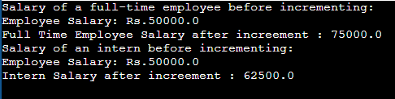
Hierarchical Inheritance

Slide 9
Method Overriding
If a base class and derived class have a method with same name but different parameter list, then it is called as method overloading.
But, If a base class and derived class have a method with same name and same parameter list, then it is called as method overriding.
Usage of Java Method Overriding
Method overriding is used to provide the specific implementation of a method which is already provided by its superclass.
Method overriding is used for runtime polymorphism
Rules for Java Method Overriding
The method must have the same name as in the parent class
The method must have the same parameter as in the parent class.
There must be an IS-A relationship (inheritance).

Slide 10
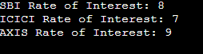
Method Overriding
class Bank{
int getRateOfInterest()
{
return 0;
}}
class SBI extends Bank{
int getRateOfInterest()
{
return 8;
}}
class ICICI extends Bank{
int getRateOfInterest()
{
return 7;
}}
class AXIS extends Bank{
int getRateOfInterest()
{
return 9;
}}
class Main{
public static void main(String args[]){
SBI s=new SBI();
ICICI i=new ICICI();
AXIS a=new AXIS();
System.out.println("SBI Rate of Interest: "+s.getRateOfInterest());
System.out.println("ICICI Rate of Interest: "+i.getRateOfInterest());
System.out.println("AXIS Rate of Interest: "+a.getRateOfInterest());
}}

Slide 11
Final class and “final” keyword
The final keyword can be preceded to any member of a class or to the class itself.
Making anything final has following implications –
If the field member is declared final then the variable value cannot be changed i.e. it becomes constant.
If a method is declared as final then that method cannot be overridden
If a class is declared as final then that class cannot have any sub class i.e. no class can be derived from a final class

Slide 12
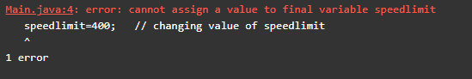
Final class and “final” keyword
Final variable : If you make any variable as final, you cannot change the value of final variable(It will be constant).
Example of final variable : There is a final variable speedlimit, we are going to change the value of this variable, but it can't be changed because final variable once assigned a value can never be changed.
class Bike{
final int speedlimit=90; //final variable
void run(){
speedlimit=400; // changing value of speedlimit
}
}
class Main{
public static void main(String args[]){
Bike b=new Bike();
b.run();
}
}

Slide 13
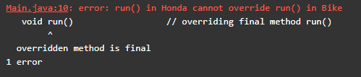
Final class and “final” keyword
Final method : If you make any method as final, you cannot override it.
class Bike{
final void run()
{
System.out.println("running");
}
}
class Honda extends Bike{
void run() // overriding final method run()
{
System.out.println("running safely with 100kmph");
}
}
class Main{
public static void main(String args[]){
Honda h= new Honda();
h.run();
}
}

Slide 14
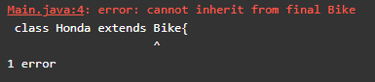
Final class and “final” keyword
Final class : If you make any class as final, you cannot extend it.
final class Bike{
}
class Honda extends Bike{ // inheriting from final class bike
void run()
{
System.out.println("running safely with 100kmph");
}
}
class Main{
public static void main(String args[]){
Honda h= new Honda();
h.run();
}
}

Slide 15
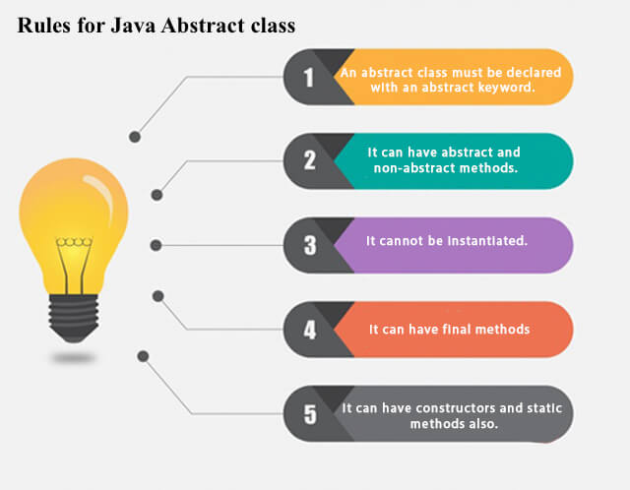
Java Abstract class and method
Abstract classes are used to declare common characteristics of subclasses.
Abstract classes are declared with keyword abstract followed by class definition. They provide template for subclasses.
No object can be made of abstract class. It can be used as a base class for other classes that are derived from the abstract class.
An abstract class can contain fields and methods. It can have abstract and non-abstract methods (method with the body).
Methods of abstract class that has only declaration and no definition are known as Abstract Methods.
Abstract methods must be overridden.
If a class has any abstract method, the class becomes abstract and must be declared as abstract.

Slide 16
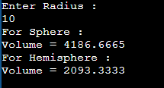
Java Abstract class and method
import java.util.*;
abstract class Abst { //abstract class
protected float r,vol;
public void read(float x) // non-abstract method
{
r=x;
}
public abstract void calculate(); // abstract method
public void display()
{
System.out.println("Volume = "+vol);
}}
class Sphere extends Abst {
public void calculate() // overriding abstract method
{
vol=3.14f*r*r*r*4/3;
}}
class Hemisphere extends Abst {
public void calculate() // overriding abstract method
{
vol=3.14f*r*r*r*2/3;
}}
class Main
{
public static void main(String args[])
{
float rad;
Scanner sc=new Scanner(System.in);
System.out.println("Enter Radius : ");
rad=sc.nextFloat();
Sphere s=new Sphere();
s.read(rad);
s.calculate();
System.out.println("For Sphere : ");
s.display();
Hemisphere h=new Hemisphere();
h.read(rad);
h.calculate();
System.out.println("For Hemisphere : ");
h.display();
}
}

Slide 17
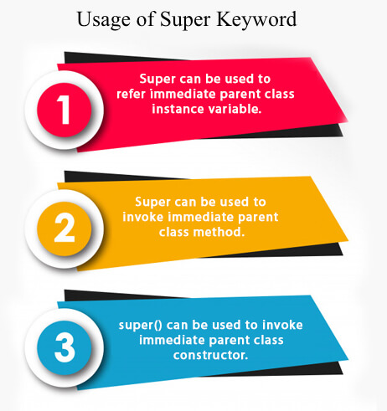
The super keyword
The super keyword in Java is a reference variable which is used to refer immediate parent class object.
If you want to access a member of a base class from the derived class, then the super keyword is used.
This is especially to access the constructors and methods of base class.
Whenever you create the instance of subclass, an instance of parent class is created implicitly which is referred by super reference variable.

Slide 18
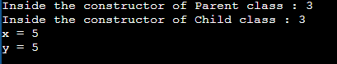
The super keyword
class Parent{
public Parent(int a)
{
System.out.println("Inside the constructor of Parent class : "+a);
}
public void display(int x)
{
System.out.println("x = "+x);
}
}
class Child extends Parent{
public Child(int a)
{
super(a);
System.out.println("Inside the constructor of Child class : "+a);
}
public void display(int y)
{
super.display(y);
System.out.println("y = "+y);
}}
class Main{
public static void main(String args[])
{
Child c = new Child(3);
c.display(5);
}
}

Slide 19
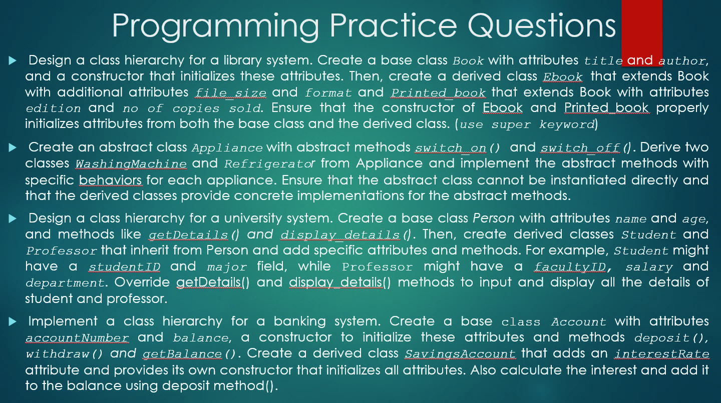

Slide 20
